Slide 1
SafeNaija AI-Powered Emergency & Crime Reporting System
OUR TEAM
Ajibade Peter
Oloko Taiwo
Oyewale Abdulsobur
Team lead
25 – 03 - 2026

Slide 2
01
02
03
PROBLEM TO BE SOLVED
We don’t know who to call
Citizens are often unsure which emergency or security agency to contact
Delayed Or Missed Reports
Critical incidents like accidents, crimes, and fires are reported late or not at all.
Risk to lives and property
Delayed reporting puts lives and property at significant risk.

Slide 3
KEY FEATURES
OUR AI SOLUTION
AI Incident Classification
Automatically identifies the type of incident (e.g., Fraud, Accident, Robbery, etc.).
Automatic Routing
Routes each report to the correct agency (Police, FRSC, EFCC, etc.)
Real-Time Location Detection
Directs reports automatically using location; no guesswork for users

Slide 4
NOVEL FEATURES
OUR AI SOLUTION
Privacy-Protected User ID
Verified User Base
Every user pre-registers with a verified NIN, ensuring traceability, accountability, and minimizing prank or false emergency reports.
Security agencies only see a masked ID, not personal NIN details maintaining user privacy while enabling authenticated reporting.
AI Understanding of Local Text
The model is optimized for Nigerian-style incident reporting, including pidgin, spelling errors, and informal language typical in real emergency messages

Slide 5
ECONOMIC PROSPECT & MARKETABILITY
Public Sector Market
Federal Government can deploy it as a unified emergency reporting platform across States & LGAs.
Security agencies (Police, NSCDC), emergency services (FRSC, Fire Service, NEMA), and health responders can use it to receive structured real-time incident reports.

Slide 6
SCALABILITY
Easy expansion to new state & new agency with simple routing updates
Can sustain a lot of users
Supports Multiple Agencies.
Voice-detection Enhancement

Slide 7
ADVANTAGES OF THE SOLUTION
Easy-to-use and save time
Safer Communities
Boosts public confidence & strengthens trust in Agencies

Slide 8
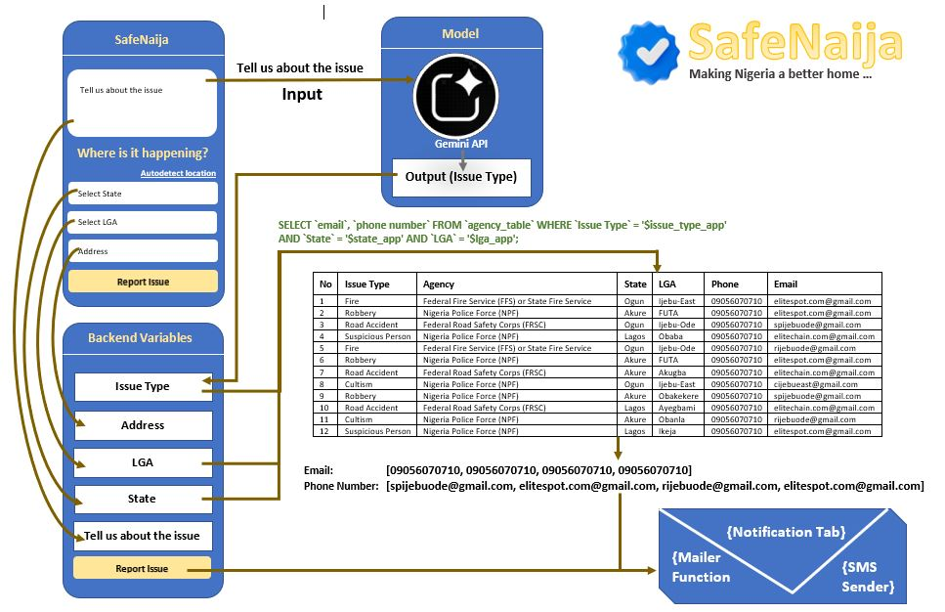
Architecture

Slide 9

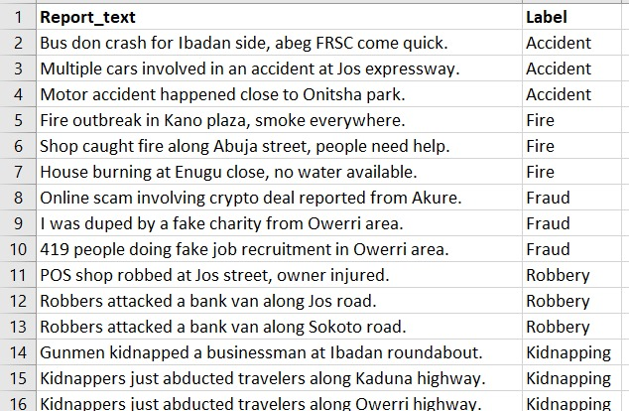
TESTING DATA SAMPLE

Slide 10
Why the Algorithm fits the problem
Gemini LLM understands short, messy, informal Nigerian English
( abbreviations, urgency).
Great for multi-class text classification without heavy datasets.
Perfect for real-time emergency routing.
New categories can be added without retraining a full model.

Slide 11
RISK & MITIGATIONS
False Alerts/Prank
Data Privacy Concern
User NIN will not be disclosed when sending report to agencies.
Anonymous mode for sensitive cases (future)
Full end-to-end encryption
Mandatory of NIN verification to ensure traceability and discourage misuse.

Slide 12
THANK YOU

